Slide 1
Lysol INCREMENTAL RECOMMENDATION
August 6th, 2024
Notes:
Hi everyone, I will be giving a Lysol Incremental Recommendation today for the Reckett Benkiser account.

Slide 2
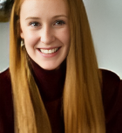
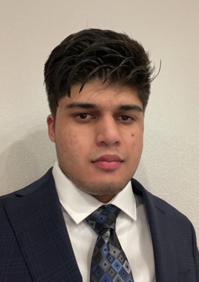

Introduction
Jessica Borer
Supervisor Strategy
Faaz Arshad
Strategy Intern
Andres Barrantes
Senior Planning Analyst
Notes:
My name is Faaz Arshad a Master’s student at Columbia University with a background in Data Science. This summer I interned as a Strategy intern on the Reckett Benkiser account under Jessica Borer, who is my supervisor. Throughout the internship I gained valuable mentorship from both Jess, and Andres Barrantes who is our teams Senior Planning Analyst. Andres is based in the Costa Rica office. Whenever, Jess was occupied with work, I would reach out to Andres to get my questions answered and to seek guidance on client related tasks.

Slide 3
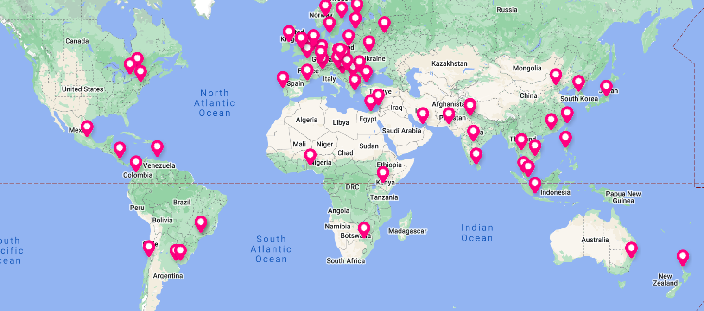
Global Reckitt Reach
Notes:
Here is a fun map of our client’s global reach. Reckitt has offices across all contents. I pulled this map from there website. They are mostly centered in Europe because Reckitt is a British based company headquartered in the UK.

Slide 4
Understanding the Task
RationalE
Goal
The ask
Proposal for $1.5MM incremental to 2H 2025 Lysol Air Sanitizer (Q3 & Q4)
There are new comms launching at the start of Q3 with new creatives and we want to invest more to have a bigger reach against our audience
Increase reach across target audience prioritizing new creative live date
Notes:
So, I was given this project this past month and my task was to provide a recommendation on $1.5 million dollar budget increase for the Lysol Air Sanitizer product. The money is to be allocated for 2025 quarter 3 and quarter 4. The clients have new comms and creatives launching at the start of quarter 3. And There goal is to use the extra 1.5 million to increase the reach across the targeted audiences prioritizing new creative live dates.

Slide 5

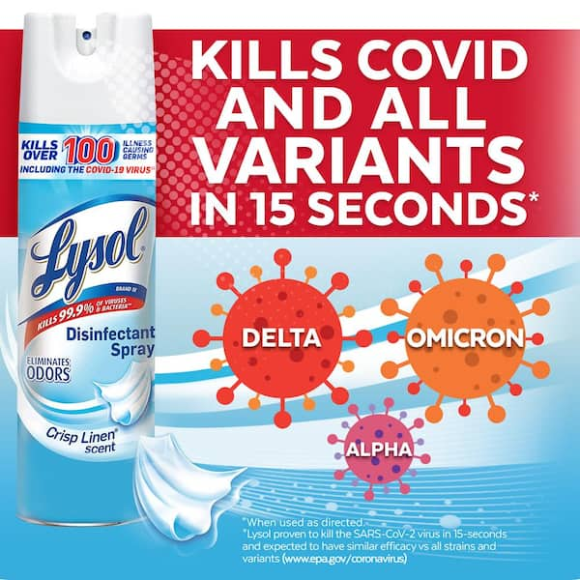
What does it Mean to Have New Comms?
New Comms Relate to when new creative is launching or there is an adjustment to copy on creative
Quarter 3
Quarter 4
Notes:
So what does it mean to have new comms. In the last slide, I mentioned that the clients are launching new creatives. Above is a good interpretation of what they typically are. In every quarter, ad campaigns, new spokesperson, new creative and new influencers might change.
These changes would speak to a different messaging. For example, as you can see in the images on the slide, in quarter 3 its more proactive than reactive. So we can say Help stop the dreaded spread of norovirus with Lysol disinfectant spray. Hoping for there regular customers and potential customers to be aware of these products and can either stock up in Q3 or buy in Q4.
Then when it is quarter 4 the messaging changes to a reactive ad campaign. So instead of saying Help we can use an attacking word like Kills covid and all variants in 15 seconds. Showing customers that they should buy the product as soon as possible to safeguard their health at home.

Slide 6
Project RoadMap
Phase 3
Phase 2
Phase 1
Allocate the proposed budget recommendation
Calculate Impressions and GRPs from new budgets to run R/Fs for comparison
Dissect the quarterly budget flow chart
Allocate the proposed budget
Client Understanding
Client Media Consumption
Notes:
So, this slide shows the 3 phases that occurred throughout this project. The first phase involved dissecting what the client wanted from me and to strategize an appropriate recommendation. Then I had to analyze the client’s media consumption to build an affective recommendation. I will be showing the media consumption chart in the next slide.
The second phase involved the budget flow charts of the current plan and the development of the proposed allocated budget.
The third phase involved the calculation of impressions and GRPs from new Budgets to run ridge frequencies for comparison. The comparison is between the current plan and the new recommended plan.

Slide 7
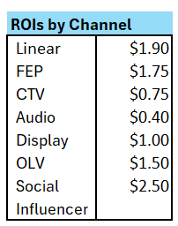
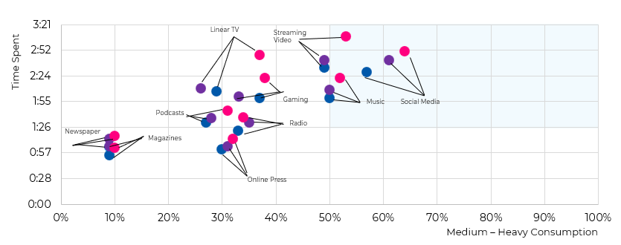
Key Factors For Decision Making
Media Consumption
Parents 25-54
HA Parents 25-54
AA Parents 25-54
Notes:
Key factors for decision making. So, This chart shows the media consumption from medium to heavy consumption with the x axis being the consumption percentage and the y axis being the time spent for each consumer type. The consumers that I and the client wanted to focus on are as follows:
Parents 25-54 , Hispanic Americans Parents 25-54, and African American Parents 25-54.
On the left of the chart you have a table showing the ROIs by channel.
As you can see this chart illustrates Linear TV, Streaming Video, and Social Media to be Reckitt’s highest drivers in terms of Return on Investment. Social is $2.50, Linear, is $1.90, and FEP is $1.75. FEP and CTV tend to fall under the same channel which is Streaming Video.
The least ROIs by channel is CTV and Audio. CTV being 75 cents and Audio being 40 cents.
Parents 25-54 from the General Market tend to watch more Linear tv, and Streaming Video. This make sense, I personally have noticed this as well but parents work the whole day and then come back from work to eat dinner and watch tv either by themselves or with family around. It is there time to relax and catch up on other things like the news.
Social media is also high across all categories of parents 25-54 because everybody connects and communicates through social media. When commuting to work on the train I always see them on social media or on there phone reading some form of content.

Slide 8
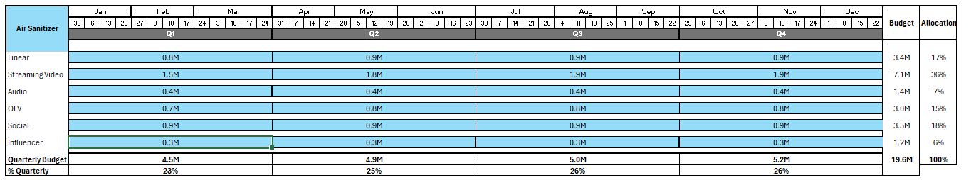
Current 2025 Air Sanitizer Plan
Current plan is a 50-50 even split across both (Q3 & 4)
Prioritizes Linear, Streaming, OLV, and Social
Flighting
Notes:
This is the current plan given to me by the client. At the moment, it is a 50 – 50 even split for both quarter 3 and 4 prioritizing all channels fairly. Quarter 3 spans from July to September while Quarter 4 spans from October to December. The pie chart above shows the percent allocation by channel types. So, as you can see Streaming Video has the most amount of money allocated followed by Social, Linear, and OLV. Influencer and Audio has the least amount of money allocated.

Slide 9
Key Factors To a Recommendation
Desirability
Feasibility
What does the client need and/or desire
What are realistic changes that we can make.
Objectives
Sweet Spot
How are we going to accomplish the job to be done and achieve our goal
Notes:
When thinking about the new recommendation you want to understand 3 key factors. Desirability, Feasibility, and Objectives. Desirability involves clients needs and wants. for us it is what does the client want to do to meet their goals, what media channels do they want to be in.
Next is Objectives. Objectives relates to goals, and results. How am I going to engineer the job to achieve the over arching task.
Last, its Feasibility. Understanding the reality behind this whole project and what is realistic with the marketplace, our budgets, channels desired, and even availability within our upfront for video.
Putting all this together will hopefully result into a solid recommendation that should please the client.

Slide 10
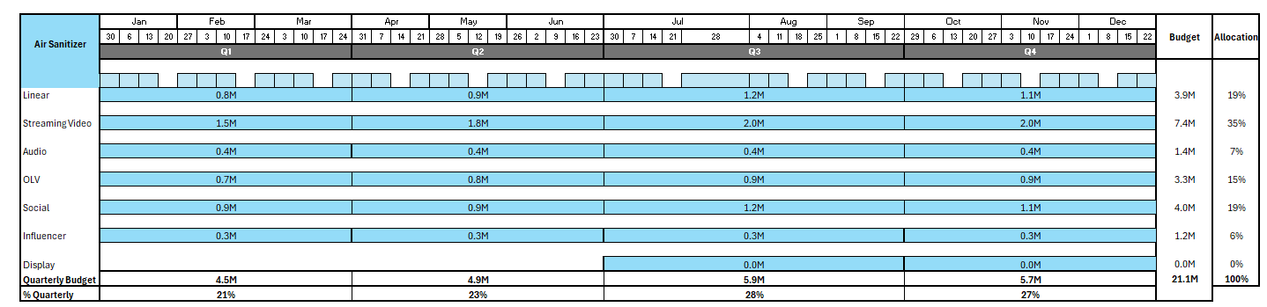
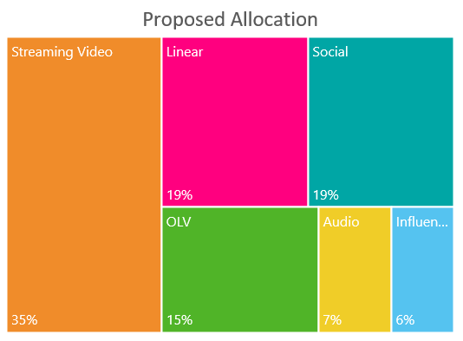
New 2025 Air Sanitizer Plan
New plan is a 60-40 across both Quarters 3 & 4
Prioritizes Social, Streaming, and Linear
Flighting
Notes:
So, my proposed plan to the client involves a 60-40 split across q3 and q4. I want to recommend the client to allocate 60 % of the money to q3 and 40 % of the money to q4.
The Treemap in the top shows a better interpretation of the allocation by percent. New Allocation is as follows: 35% for Streaming Video, 19% for Social, 15 % for OLV, 19% for Linear, 7 % for Audio, and 6 % for influencer.

Slide 11
Current vs Recommended channel mix
Rationale
New Creatives launching in Q3 budget priority 60-40
Social media has higher allocation due to consumption alignment and high ROI ($2 ROI)
OLV is a Reach driver (helps build reach for the brand)
Linear and Streaming are mass awareness drivers for the brand with high ROIs as well.
Notes:
Now that the new plan has been recommended, we can see the comparison between the current plan and recommended plan mixes.
The rationale behind the new plans was due to the client’s new comms and creatives being launched in q3. This meant that I had to allocate more money towards q3 to help campaign the new creatives.
Next, in the Recommended chart you can see social increased from 18% to 19%. Social includes platforms like, Facebook, Instagram, reels, and tiktok. Social is a mass awareness driver and delivers on ROI.
I wanted social’s allocation to increase because everyone uses social media and you have a far better reach on those platform compared to the others. Linear gets an increase from 17% to 19% due to the older audience that still watches cable. Linear is huge amongst the older audience. Vendors for Linear include abc, cbs, or nbc.

Slide 12
Lysol Air Sanitizer Reach Analysis
Reach & Frequency | Q3 | Q4
Current Plan Omi Video | 70% | 2.9 | 71% | 3.0
Current Plan Holistic | 87% | 9.5 | 88% | 7.1
Recommended Plan Omi Video | 73% | 3.2 | 73% | 3.3
Recommended Plan Holistic | 91% | 12.4 | 89% | 10.5
Notes:
In this chart you can see the % Reach 1+ for Quarter 3 , 4, and Total current and new plans. Frequency is how many times the viewer sees the campaign average. The frequency is higher in q3 due the amount of money being pored into q3 hence why q4 has a smaller budget than q3 .
Throughout the recommendation I noticed that Q3 and Q4 increased from the current plan and the goal from the beginning was to increase the plan.

Slide 13


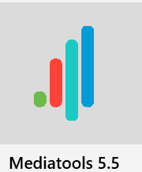


What I learned?
Strategy
Tactical
Execution
Launch
Tools Used
Notes:
Throughout this internship, I learned a lot of technical skills like PowerPoint, Excel, Media Tools, Video Optimizer and Nielsen. I learned how to process an effective strategy. Participated in meetings to understand tacticals and execution. I gained knowledge on when I should use what tool to get the most affective outcome as well as how to properly communicate my finds to my fellow team members.
I learned more about Lysol more than I ever have in my entire life. So, now every time when I see a Lysol product in store or on the various channels, I will remember who is responsible for that.

Slide 14

Program Recap
Fun Memories
Free Snacks & Company lunch
Networking
Fieldtrip
Lunch & Learns
Marcel Classes
Marcel Group Discussions
Notes:
In terms of the program, I gained a lot of soft skill experience through the Marcel Classes, the lunch and learns, and the marcel group discussions. I loved the free snacks and company lunches as well as the field trip to channel 11.
In the future, I hope to use the skillsets learned in this internship and apply them to real world projects.
That’s all I got. Thank you!

